Slide 1

Davis County
CDBG Annual Training

Slide 2
PY24
CDBG Grants

Slide 3
Welcome
Introductions
  Ryan Steinbeigle – Grant Administrator
  Chanel Flores- Economic Development Director
  Dakota Wurth- Housing Coordinator
2024 Program Year

Slide 4
Overview – Community Development Block Grant
Community Development Block Grant (CBDG)
Funded by the U.S. Department of Housing and Urban Development (HUD) since 1974
Objective is to principally benefit Low-to-Moderate Income (LMI) persons
Competitive Grant Program used to fund Housing, and other Community Development Projects
Davis County has been an Entitlement County since 2011
13 participating cities and the unincorporated County (Clearfield and Layton are separate CDBG Entitlement Cities)
To assist in Developing Viable Communities by Providing Decent Housing, a Suitable Living Environment and Expanding Economic Opportunities, Principally for Persons of Low and Moderate Income.”
-U.S Dept. of Housing and Urban Development
Notes:
Federal Formula Grant
Each year Davis County gets an allotment, but won’t in 2023. Discuss why and plan.

Slide 5
CDBG 2024 Program Year
Applications Reviewed
Notice of Awards
2024 CDBG Subrecipient Agreements/Final AAP
2024 NOFA
NOV 15, 2023
FEB 20, 2024
MAY 2024
MAY-JUNE 2024
JAN 8-FEB 11, 2024
APR 2024
JULY 1, 2024
JUNE 30, 2025
2024 CDBG Program Year
Application Period
Annual Action Plan (AAP) Public Hearing

Slide 6
Available Funding and Project Types
  SSBG and CDBG Public Service:
    Homeless Services
    Food Insecurity
    Domestic Violence
    Mental/Behavioral Health
    Child Abuse
    Senior Services
  CDBG Infrastructure/Housing/Public Facilities:
    ADA Ramps
    Waterlines/Roads/Sidewalks
    Affordable Housing
    Rent Vouchers
    Home Repair

Slide 7
2021-2025 Consolidated Plan Priorities
Public Facilities & Improvements
  Improve and expand public facilities and infrastructure that is essential to improved quality of life.
  Budget - $1,087,045
Housing
  Expanding access to safe and affordable housing for low- and moderate-income (LMI) residents
  Budget - $1,365,500
Public Services
  May allocate up to 15% of CDBG funds to public services that provide services to low- to moderate-income persons or prevent homelessness
  Budget - $444,000
Administration
  Administering federal funds and ensuring compliance is a critical part of utilizing federal resources
  Budget - $705,000
Economic Development
  May have projects that help to support microenterprise development for low- and moderate-income residents
  Budget -$41,500
Notes:
Must develop plan every 5 years to set community priorities
Estimate the amount of money over 5 years we’ll invest in each priority

Slide 8
Analysis of Impediments to Fair Housing
The CDBG program contains a regulatory requirement to affirmatively further fair housing based upon HUD’s obligation under Section 808 of the Fair Housing Act.
As a recipient of HUD CDBG Entitlement funds, the County is committed to affirmatively furthering fair housing choices for all residents. Although many issues that affect fair housing choice have been identified, the county is limited in resources and ability to impact all areas.
IMPEDIMENT #1 – Limited English Proficiency
  Provide consistent and even Fair Housing services, outreach, and support to all citizens and program applicants.
  Develop a Language Assistance Plan (LAP). Expand Davis County’s HUD-funded programs’ outreach to include Spanish translation and outreach to Spanish-speaking citizens
IMPEDIMENT #2 – Lack Familiarity with Fair Housing Act
  Increase awareness and compliance with Fair Housing laws
IMPEDIMENT #3 – Lack of informational and outreach activities
  Increase informational and outreach activities in Davis County
IMPEDIMENT #4 – Lack of record maintenance of fair housing activities
  Improve record keeping and reporting of fair housing activities
Notes:
County does an assessment of impediments to fair housing as part of ConPlan development
1st impediment is those with limited English proficiency: Public notices related to CDBG are available in Spanish and residents can request a translator for public meetings/trainings
2nd impediment is that most people lack familiarity with fair housing act: We’ve published our Analysis of Impediments to Fair Housing on County website which contains information about fair housing act and steps County is taking.
3rd impediment is a lack of informational and outreach activities. County has made some strides here, but is looking into other ways be can get information out to residents
4th impediment is a lack of record maintenance of fair housing activities: County is documenting our efforts to address all impediments to fair housing.

Slide 9
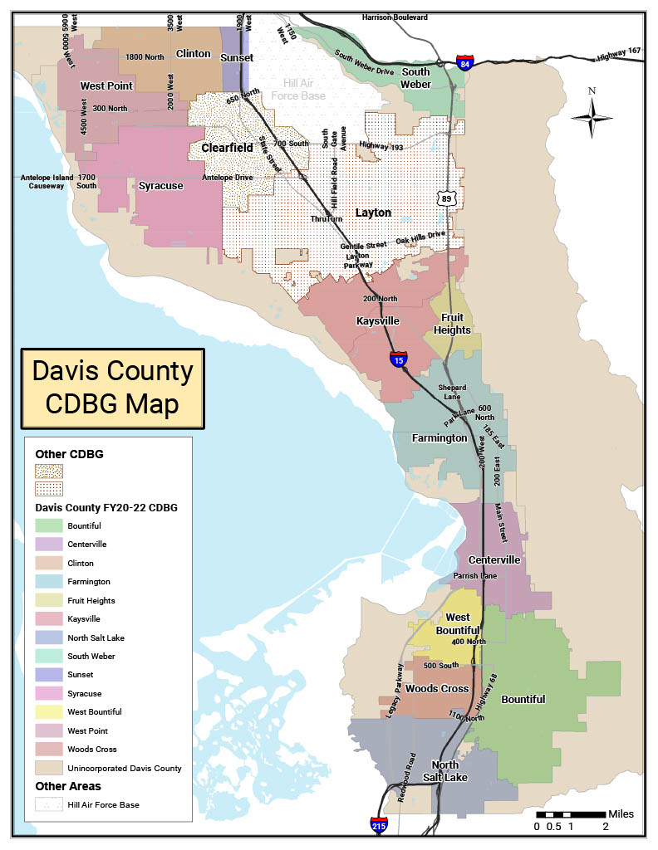
CDBG Eligible Area 2024
Eligible Areas:
Bountiful
Centerville
Clinton
Farmington
Fruit Heights
Kaysville
North Salt Lake
South Weber
Sunset
Syracuse
West Bountiful
West Point
Woods Cross
Unincorporated Davis County
Davis County Map
Notes:
Organizations can be located in Layton and Clearfield if they serve the entire community.

Slide 10
Program Requirements

Slide 11
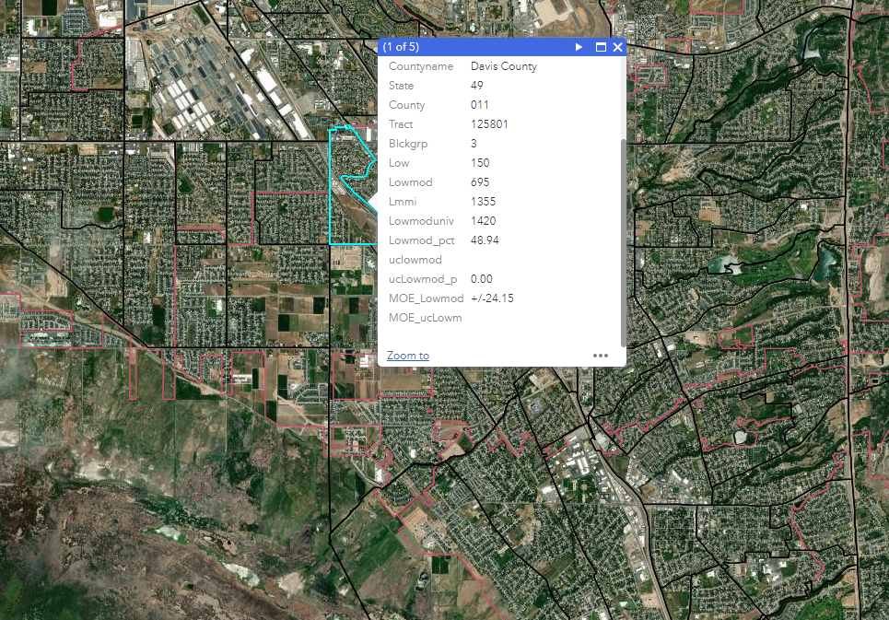
National Objectives
Low Income Area (LMA)
  An area benefit activity is an activity which is available to benefit all the residents of an area which is primarily residential
  An activity must meet the identified needs of LMI persons residing in an area where 47% of the residents are LMI persons. (Davis County is exception grantee)
Low Income Clientele (LMC)
  Activity which serves clientele that are documented to be low income (income verification) or “Presumed LMI.” (e.g. homeless, elderly, abuse victims)
  At least 51% of the beneficiaries of the activities must be LMI or “Presumed LMI.”
Low Income Housing (LMH)
  Activities which assist in the acquisition, construction, or improvement of permanent residential structures, may qualify as benefitting LMI persons only to the extent the housing is occupied by the LMI persons.
  Benefits is based on households not persons
Notes:
Primary requirement is that any funded activity must meet a national objective. The primary or principal objective to CDBG is to serve Low to Moderate Income Families.
This includes projects that:
Provide a benefit to the residents of an area that is principally low-income, which in Davis County is 47% or more of the residents are low-income.
The activity must serve a clientele that is principally low income. This means there must be documentation showing that at least 51% of the beneficiaries are low-income or the beneficiaries are “presumed low-income”
Housing projects for low-moderate income families. This could be projects to construct affordable housing, home rehabilitation projects for homeowners who are low-income, or purchasing an existing structure to convert it to low-income housing.
There are other national objectives that qualify, but these are the three that align with the prioirties outlined in the County’s Consolidated Plan.

Slide 12
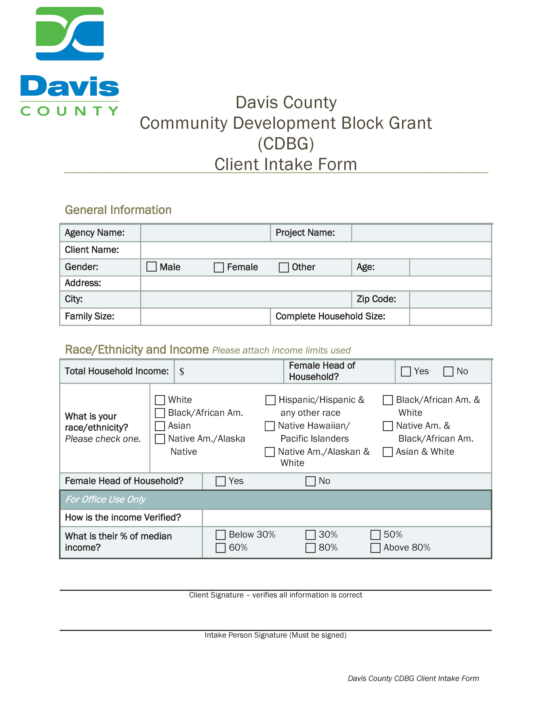
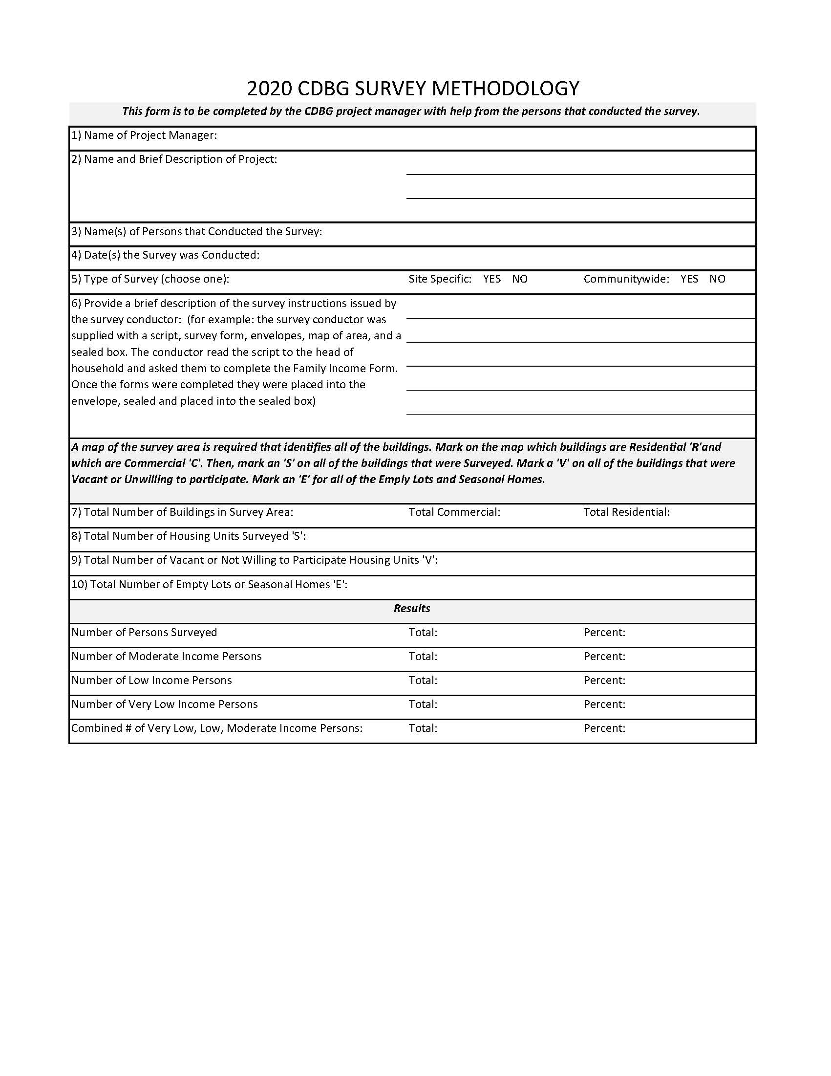
National Objectives (cont.)
Determining Eligibility
LMA
  Block group is 47% or greater LMI (Exception Grantee)
  Survey to determine service area is LMI
LMC
  Presumed to be LMI
  Income verification
    Self-certification okay if not receiving direct financial benefit.
    Always better and safer to have documentation
Whatever National Objective you’re program is achieving with CDBG funds, the methodology used must all be documented and retained in your files for that activity.
Notes:
For Low-Moderate Income Area benefit projects there is two ways to determine eligibility.
You can use HUD’s online mapping tool to see if the project is in a census block group that has been identified as having more that 47% of the residents as low-income
Or, if there is a very specific area, say constructing a sidewalk around a mobile home park, so the residents benefiting are very specific and not the entire census block group, you can survey all the residents who will benefit from the project to show that at least 47% are low-moderate income.
For Low-Moderate Income Clientele Activities there are also two ways to determine eligibility.
The activity can be one that serves clients who are presumed to be low-income. For example a homeless shelter, domestic violence shelter, food bank, senior center, etc.
The activity can income verify clients receiving services. Income verification is always best done by requiring a tax return or two months paystubs and must be done when providing direct financial benefit (e.g. grants/loans to purchase a home), but CDBG regulations do allow self certification of income. If determined though that clients were not low income you will get a finding and maybe be disqualified from future participation.

Slide 13
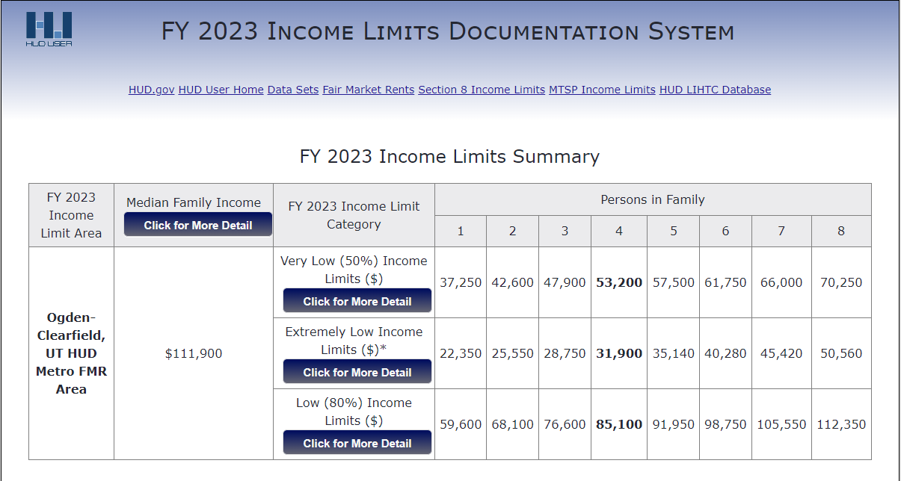
Income Limits FY23
At least 70% of CDBG funds are statutorily required to be expended on LMI serving activities.
51-80% of area median income = moderate-income
30-50% of area median income = low-income
Under 30% of area median income = very low-income
Can be found on the County CED or HUD’s website

Slide 14
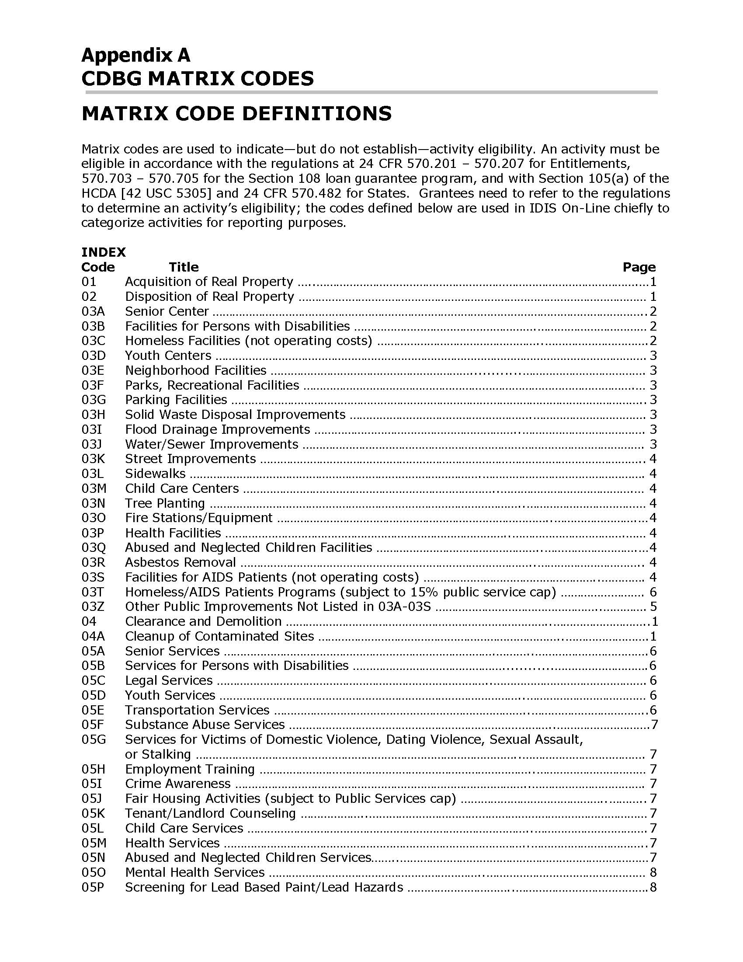

Matrix Codes
CDBG Activities must fit within the prescribed Matrix Codes.
The Codes relate to the National Objectives and the goals reported to HUD .
The Matrix Codes and National Objectives relate to the County’s Consolidated Plan.
All Matrix Codes are available on the County website and in Neighborly.
As part of the County Consolidated Plan only the following activity types will be funded:
  Housing
  Infrastructure/Public Facilities
  Public Services
Notes:
HUD has Matrix Codes used to determine the eligibility of every activity that gets funded. Your project must align with a Matrix Code and fit within the County Consolidated Plan activities (e.g. Housing, Infrastructure/Public Facilities, or Public Services)
Will be available in Neighborly.

Slide 15
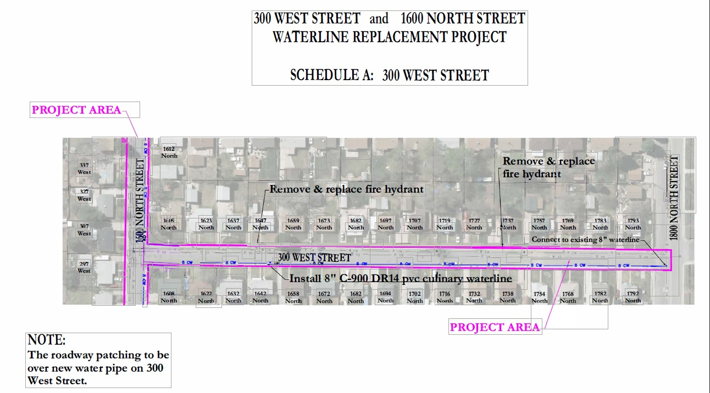
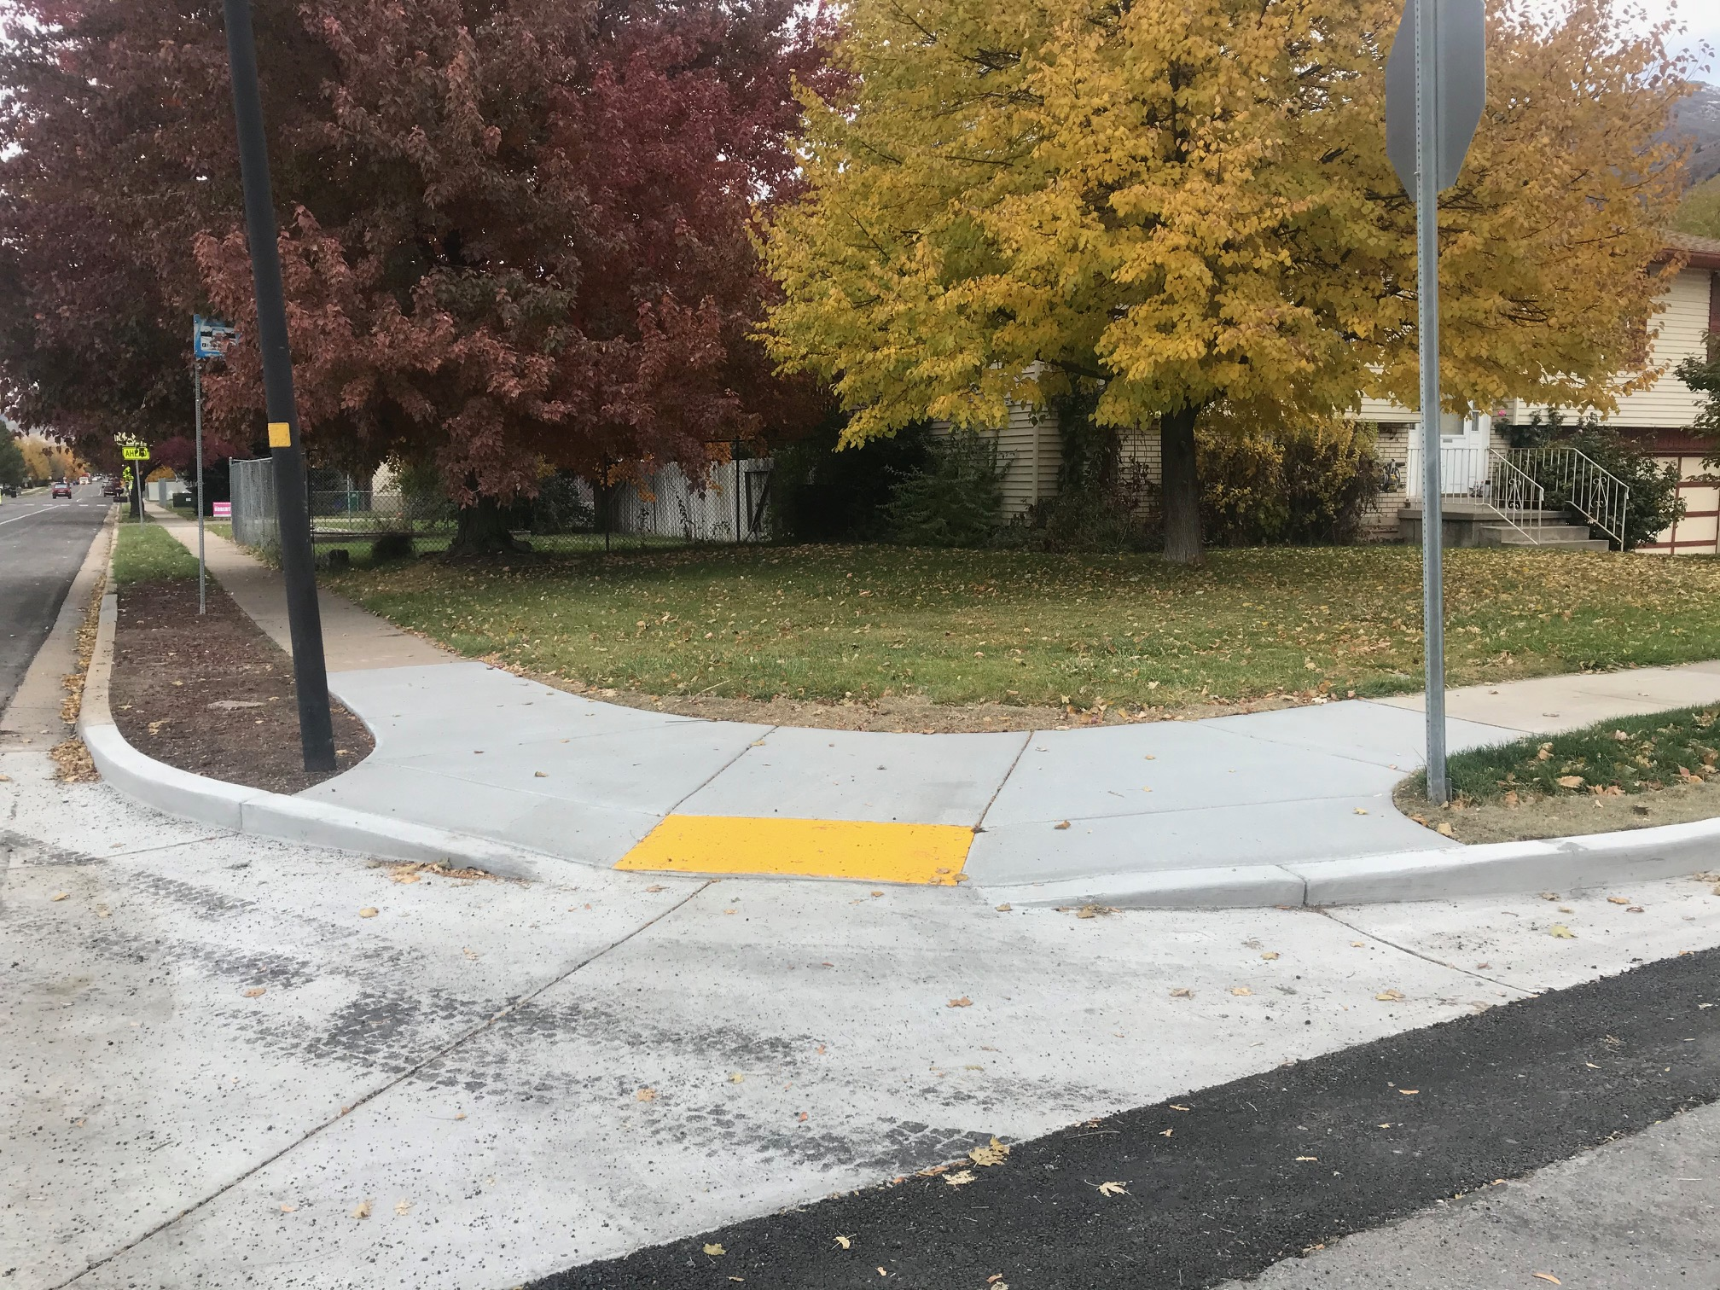
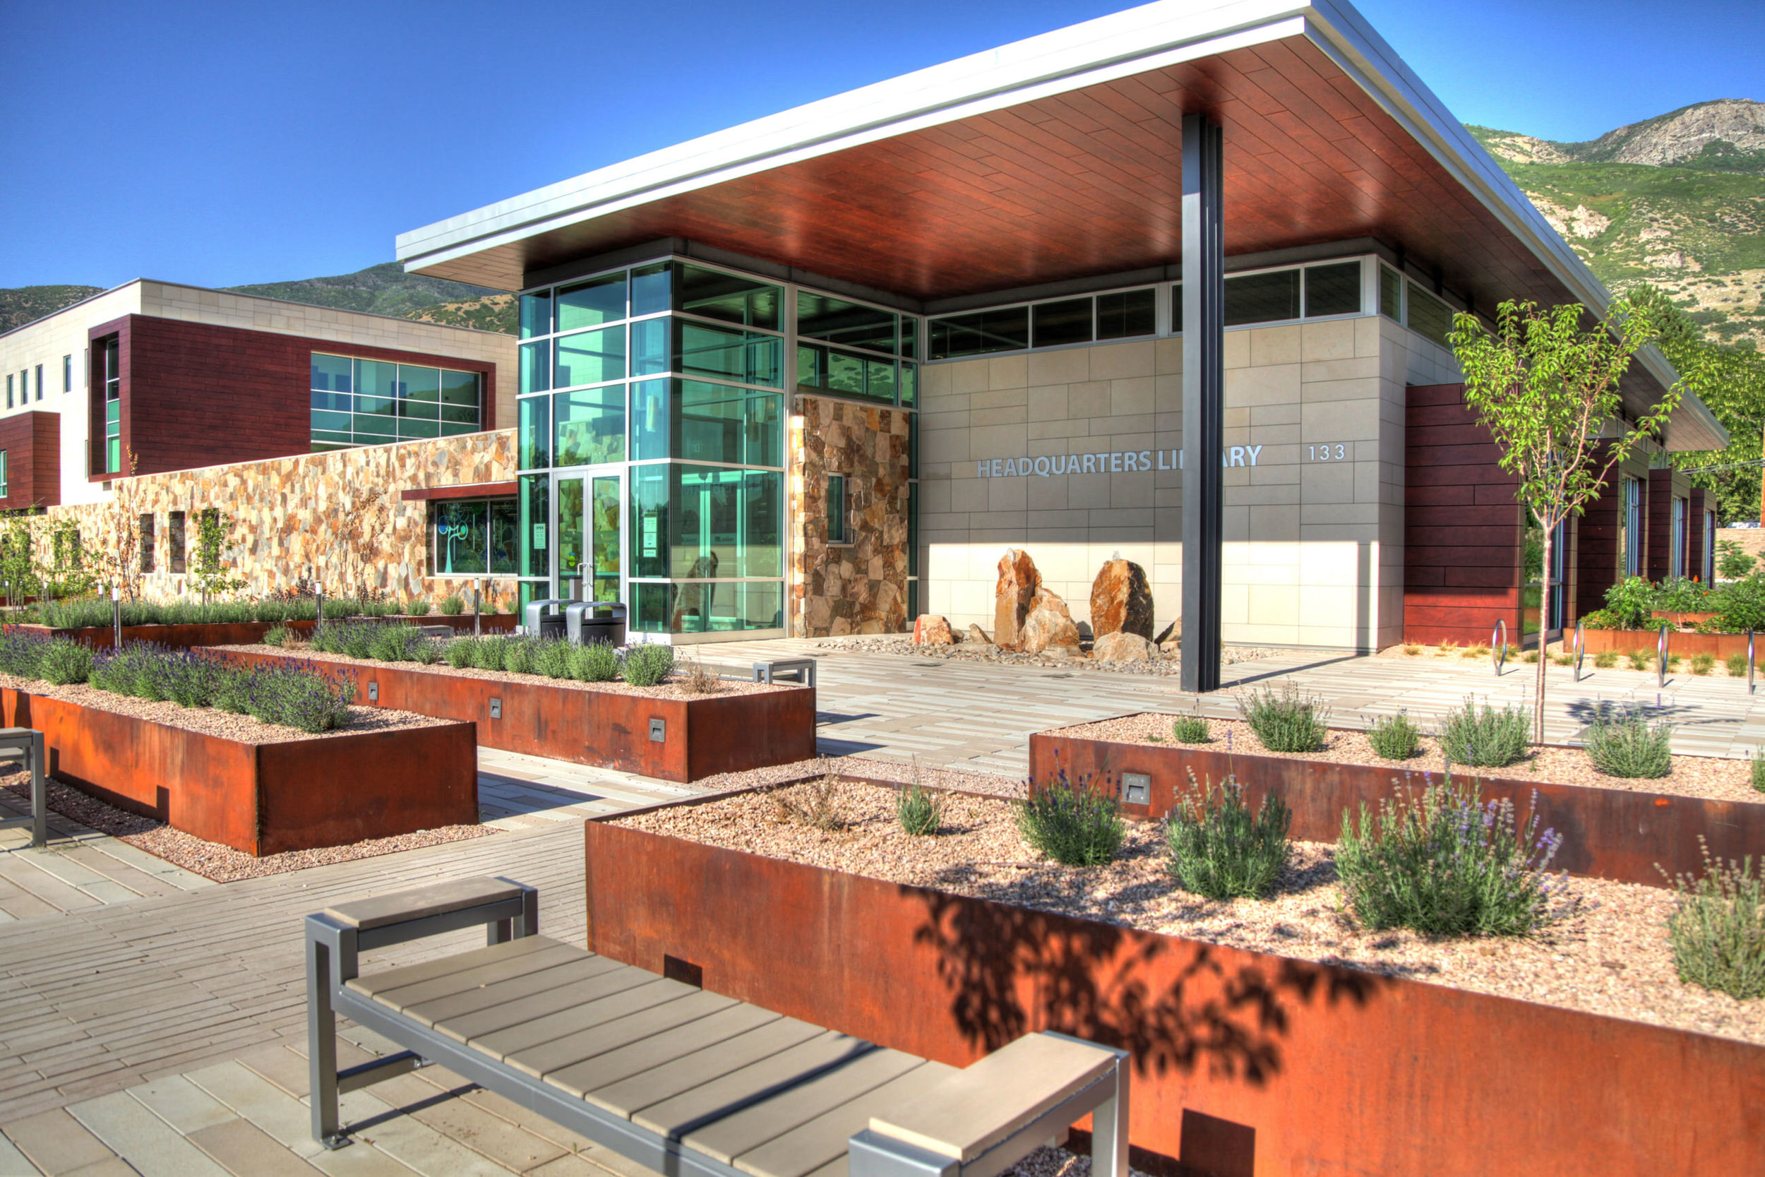
CDBG Public Facilities and Infrastructure
Eligible Applicants:
  Cities, special service districts, Davis County departments, non-profits
  with facilities available to the public (e.g. homeless shelters)
Eligible Activities
  Land acquisition
    Construction of a new public facility
  Infrastructure
    Sewer/water projects
    Storm drains
  Public Facilities
    Sidewalks/street improvements (e.g. ADA Ramps)
    Remodel of public facility (e.g. Senior Center)
    Parks/recreational facilities

Slide 16
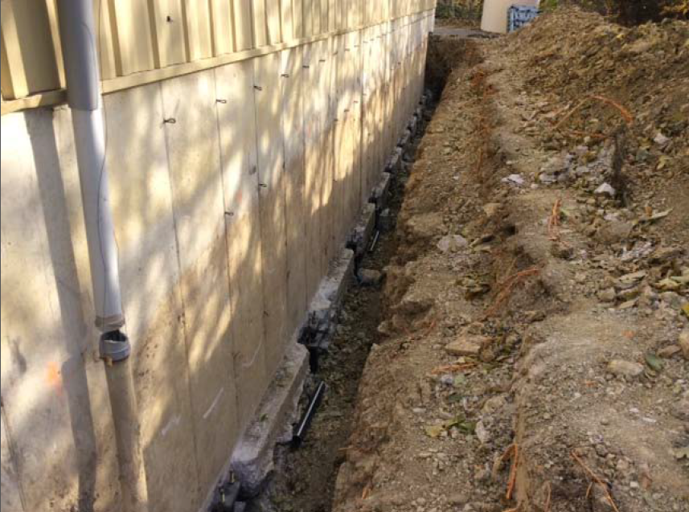
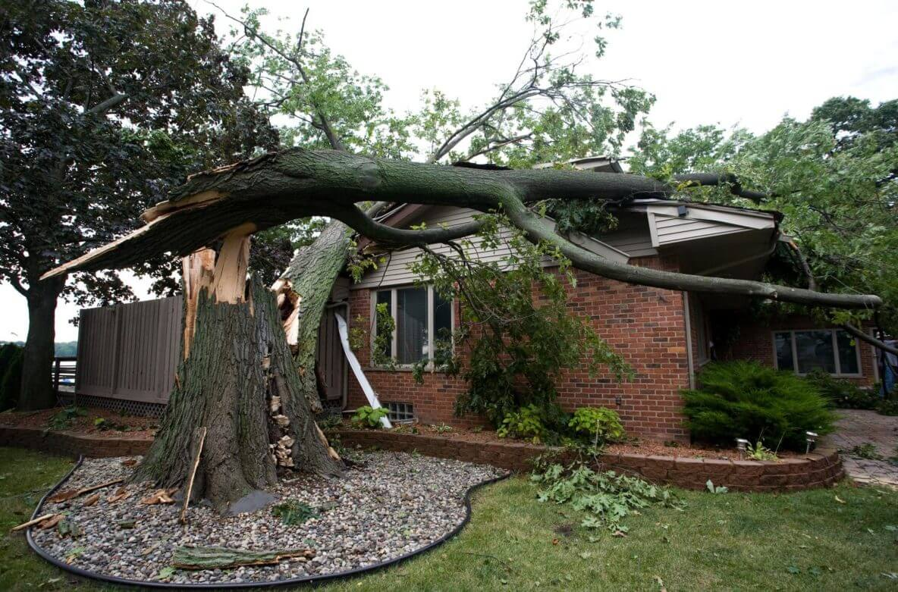
CDBG Home Ownership & Rehab
Eligible Applicants:
  Cities, housing authority, non-profits
  Davis County runs Homeownership Assistance Program
Eligible Activities
  Residential Rehab
    Roof repair
    Structural deficiencies
    Lead paint abatement (homes built before 1978)
    Weatherization
    Energy Conservation
    Reconstruction (e.g. replacing substandard housing)
    Projects to create affordable housing (e.g. purchasing a building with intent to convert to low-income housing)
    Loans to Homebuyers

Slide 17



CDBG Public Services
CDBG Public Services (15% CDBG)*
CDBG recipients must provide activities that serve clients at or below 80% AMI, who live in the “Urban County” area.
Activities include:
  Services to Persons with Disabilities
  Youth Services
  Transportation
  Child Care Services
  Substance Abuse Services
  Services for Victims of Domestic Violence
  Mental Health Services
  Food Banks
  *Nonprofit entities which directly provide human services to Davis County residents are eligible to submit proposals for CDBG

Slide 18
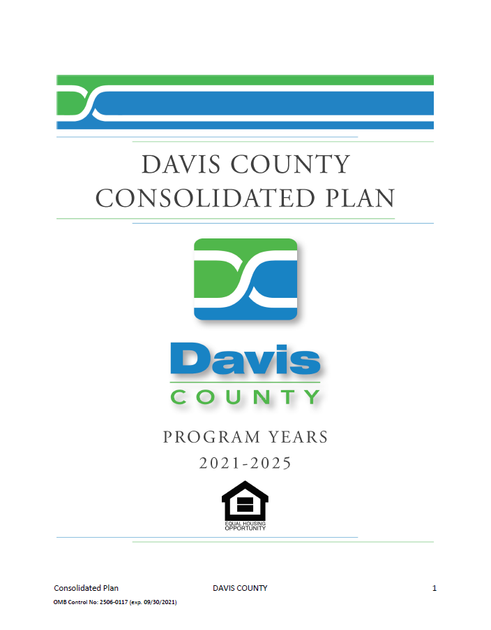
Quarterly Reporting
All projects must align with the County’s 2021-2025 Consolidated Plan
  Plan is available on Davis County CED website
County is required to report to HUD on a quarterly basis.
  Must report project/program progress and demographics of those assisted.
    Ethnicity
    Income levels
    Lead remediation (Rehab projects only)
    Number with new or improved access to service/benefit (public services)
    Homeless persons given shelter or beds created (may not be applicable)
Infrastructure/public facilities and home rehab projects must report progress on quarterly basis
  Even if no work has begun in previous quarter, still must report on project status
Notes:
County is required to report project progress outcome on a quarterly basis. Reporting is due within 15 days after a quarter ends.

Slide 19
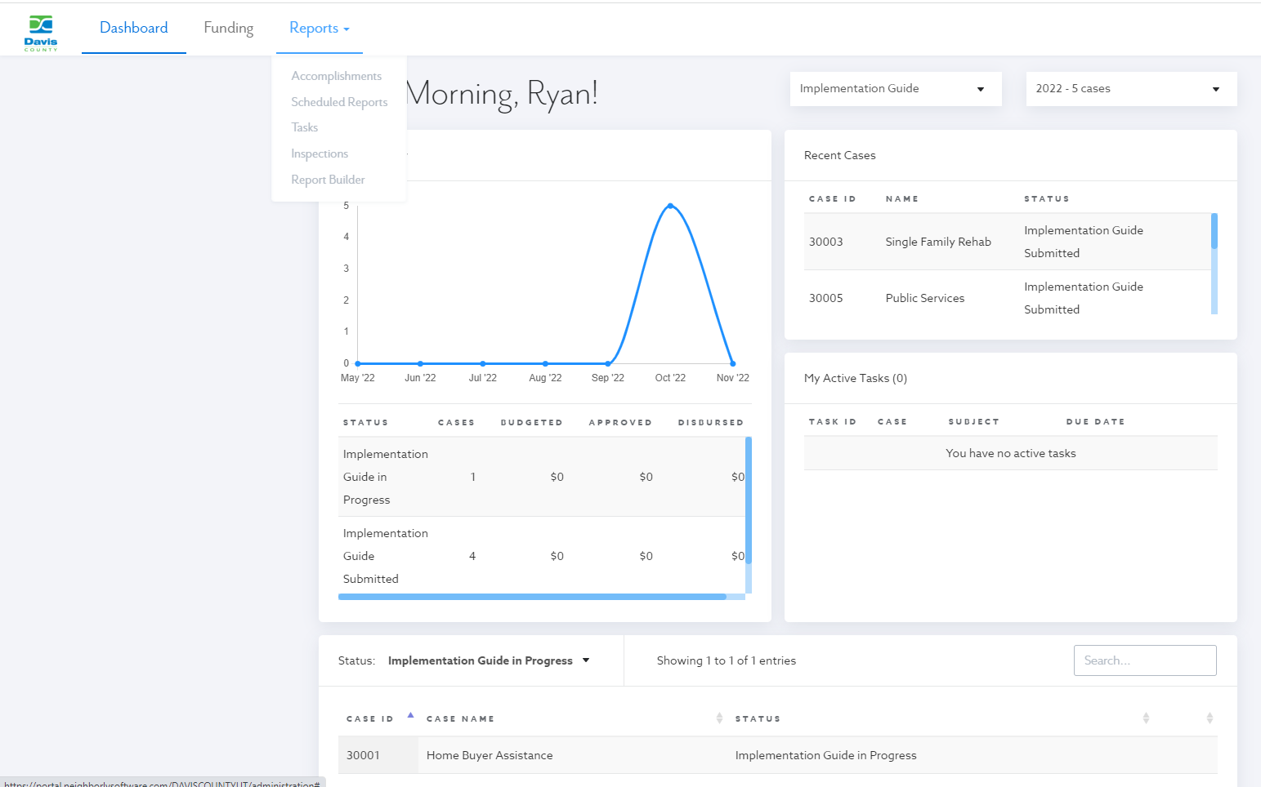
Reporting in Neighborly
Quarterly Reports
All subrecipients are required to report their data thru Neighborly
Neighborly will send reminders when reports are due.
If Quarterly Report is not filled out the County reserves the right to withhold payment to the Subrecipient
If there are extenuating circumstances, please talk with CDBG Staff.

Slide 20
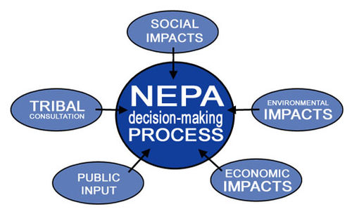
Environmental Review
ALL CDBG PROJECTS ARE SUBJECT TO ENVIRONMENTAL REVIEW PROCESS
Required per §24 CFR 50.4 and 58.5 USC under the National Environmental Review Policy Act (NEPA)
Projects Approved by the Review Committee will not receive funding until the review process is complete.
Any Projects requiring an Environmental Assessment (EAS) or higher will require prior approval and may be delayed due to the higher costs associated with this level of review.
Any project needing an Environmental Impact Study (EIS) will be evaluated on a case-by-case basis
“An environmental review is the process of reviewing a project and its potential environmental impacts to determine whether it complies with the National Environmental Policy Act (NEPA) and related laws and authorities. All HUD-assisted projects are required to undergo an environmental review to evaluate environmental impacts.”
Notes:
All projects that are selected by our review committee much have an environmental review. This is something that we at the County do and we initiate immediately after the project is selected so that the contracting process can begin. Any project that requires a more extensive Environmental Assessment or a full environmental impact study will be evaluated on a case-by-case basis because of the level of review and cost associated with doing these.

Slide 21
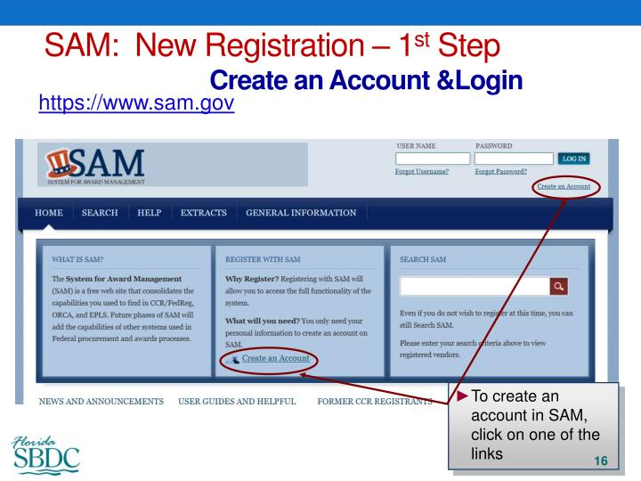

2 CFR Part 200
Grants Financial Management
SAM.gov
  All subrecipients, contractors and sub-contractors receiving federal dollars must register
  UEI/CAGE Numbers required for grant
Debarment
  For Contractors/Subcontractors for any project receiving federal dollars
  Single Audit Requirements
  If your organization receives over $500,000 in federal funding you must submit your single audit as part of the application
    DOT, FEMA, USDA, NRCS, EPA, et al…
Notes:
All entities accepting federal funds are subject to the audit requirements under 2 CFR 200; for 2022 the County will require that organizations have a federal funds policy

Slide 22
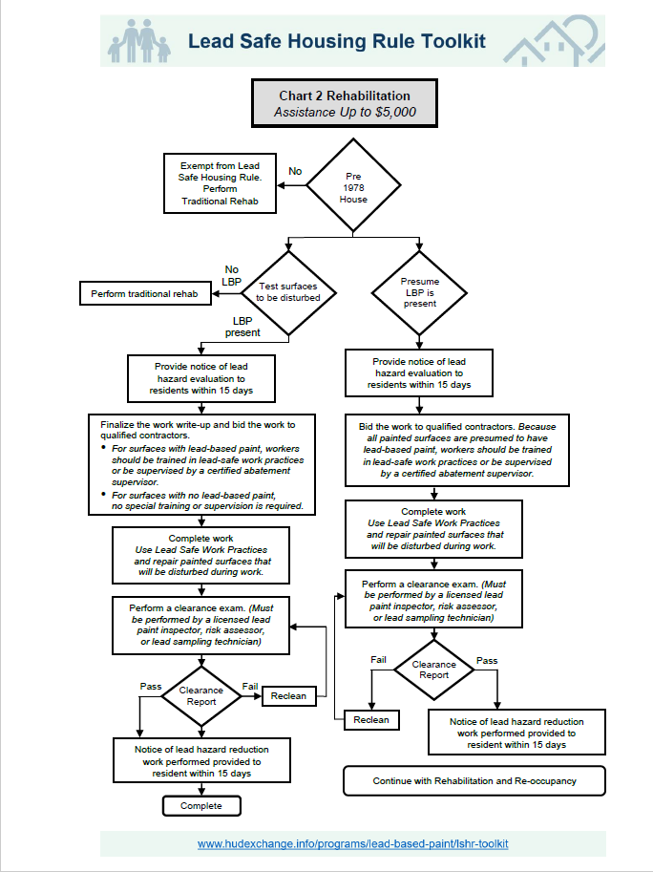
Lead Safe Home Requirements (LSHR)
Applies to all single and multi-family rehab projects
Homes/buildings constructed after 1978 do not have to test for lead paint
  File should contain documentation showing property was built after 1978 and LSHR exempt checklist
Homes/buildings constructed before 1978 and will disturb painted surfaces must have inspection
  Occupants must be provided notice within 15 days
If lead paint discovered, abatement must be performed.
  Steps will change depending on amount of federal funding provided toward project.

Slide 23
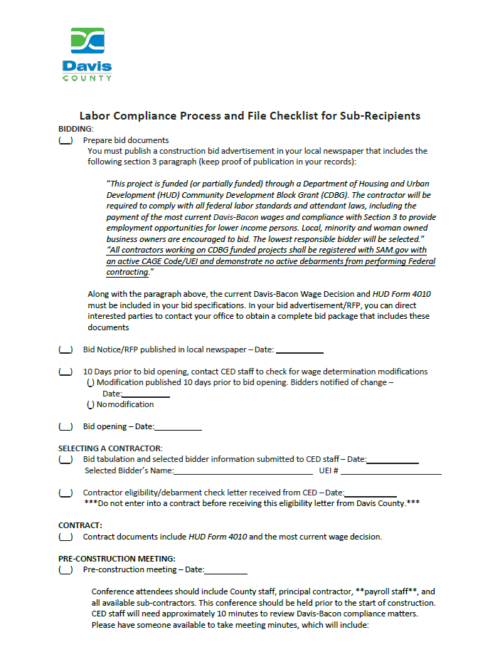
Labor Requirements
The Davis-Bacon Act
  Applies to contractors and subcontractors performing work on federally funded or assisted contracts over $2,000.
  All laborers must be paid no less than the prevailing wages and fringe benefits.
Wage determination
  County will provide wage determination for the labor classification for your project type.
  Davis County must attend pre-construction meetings.
Contract Work Hours and Safety Standards Act
  Contract over $100,000 require overtime pay (time and one-half) for hours worked over 40.
Documentation
  Must have records of labor interviews and wage data during project.
  Proof of bid solicitation with section 3 language
  Photos of Davis Bacon posters, wage determination & HUD 4010 on-site
Notes:
All construction projects (except single family home rehab projects under 8 units) are required to comply with Federal Labor Regulations.
This includes Davis-Bacon Act which requires that all laborers are paid prevailing wages and fringe benefits. County will provide a wage determination for the labor classification(s) for your project.
Additionally, the Contract Work Hours and Safety Standard Act require that any construction project over $100,000 must pay workers time and a half for hours worked over 40.
The County has developed a checklist that outlines all of the labor standards documentation and requirements for construction projects. This includes public requests for proposals published in the standard examiner with required section 3 language, bid tabulations and low bid selection, pre-construction meetings that the County must attend, and so on. It is critical that you follow and complete all of the items on this checklist and provide that documentation to the County when requesting final reimbursement for the project.

Slide 24
Universal Relocation Assistance Policies Act of 1970
“The Uniform Relocation Assistance and Real Property Acquisition Act (URA), is a federal law that establishes minimum standards for federally funded programs and projects that require the acquisition of real property (real estate) or displace persons from their homes, businesses, or farms. The URA's protections and assistance apply to the acquisition, rehabilitation, or demolition of real property for federal or federally funded project(s)”
The URA provides important protections and assistance for people affected by the acquisition, rehabilitation, or demolition of real property for Federal or federally funded projects.
This law was enacted by Congress to ensure that people whose real property is acquired, or who move as a direct result of projects receiving Federal funds, are treated fairly and equitably and receive assistance in moving from the property they occupy.
Notes:
Any property acquisition falls into the URA.

Slide 25

Build America, Buy America Act (BABA)
BABA applies to all CDBG “infrastructure” projects and requires that all iron, steel, manufactured products, and construction materials used in an “infrastructure project” must be produced in the United States
  Construction Materials: (1) Non-ferrous metals, (2) Plastic and polymer-based products (including polyvinylchloride, composite building materials, and polymers used in fiber optic cables), (3) Glass (including optic glass), (4) Fiber optic cable (including drop cable), (5) Optical fiber, (6) Lumber, (7) Engineered wood, and (8) Drywall.
  Manufactured Products: Articles, materials, or supplies that have been: (i) processed into a specific form and shape; or (ii) combined with other articles, materials, or supplies to create a product with different properties than the individual articles, materials, or supplies. (Doesn’t apply until 2025 CDBG program year)
General Applicability Waivers
  Small Grants: Projects with a total cost of less than $250,000
  De Minimis: Cumulative total of no more than 5 percent of the total cost of the iron, steel, manufactured products, and construction materials, up to a maximum of $1 million.
  Exigent Circumstances: Urgent need to immediately complete an infrastructure project because of a “exigent circumstances,” or a threat to life, safety, or property of residents and the community
  Additional Waivers (Must be approved by HUD):
    Materials needed are not available in sufficient quantity or quality
    Domestic procurement would increase cost by more than 25%
    Public Interest
Notes:
Any property acquisition falls into the URA.

Slide 26
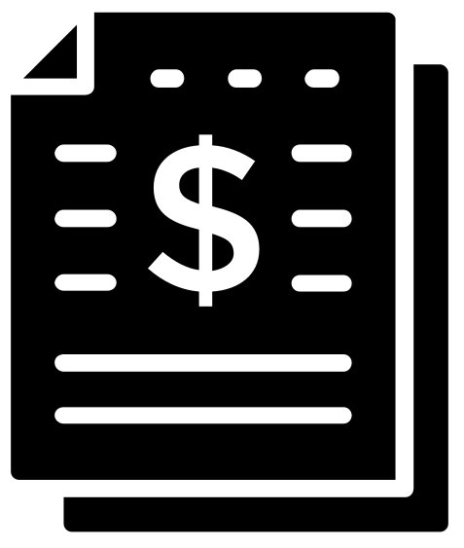

Invoicing
Invoicing for CDBG expenses
Reimbursement requests and reporting should be submitted on a quarterly basis through Neighborly
  Due: October 15, January 15, April 15, July 8
  Include all supporting documentation (e.g. receipts, invoices, cancelled checks, payroll reports, timesheets, etc))
Supporting documentation will be uploaded in Neighborly with reimbursement requests.
At closeout of program year, all compliance documentation will need to be submitted.
The County will not reimburse for expenses that weren’t included in the project budget and those that are lacking supporting documentation.
  See 2 CFR 200.403(c) & (g) 2 CFR 200.404 Cost Allocability/Allowability

Slide 27
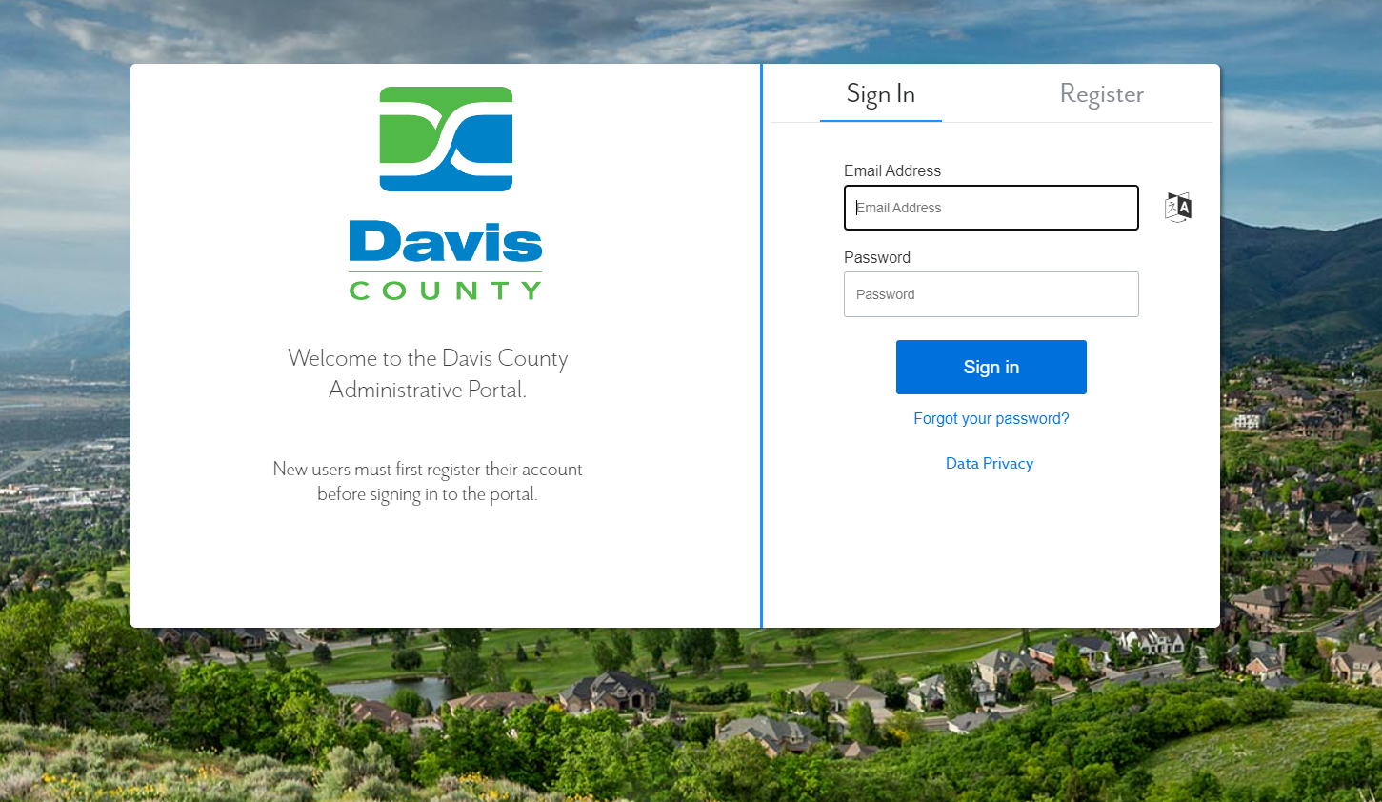
Grant Application (Neighborly)
Application will be submitted via Neighborly starting January 8, 2024.
  Application will close February 11th, 2024
Application questions will be mostly the same as last year.
  Cities need resolution from city council approving application.
Platform is very intuitive and easy to use.
  Will provide training for anyone interested.
  Anyone submitting an application and submitting reimbursement requests/quarterly reports will need an account.

Slide 28
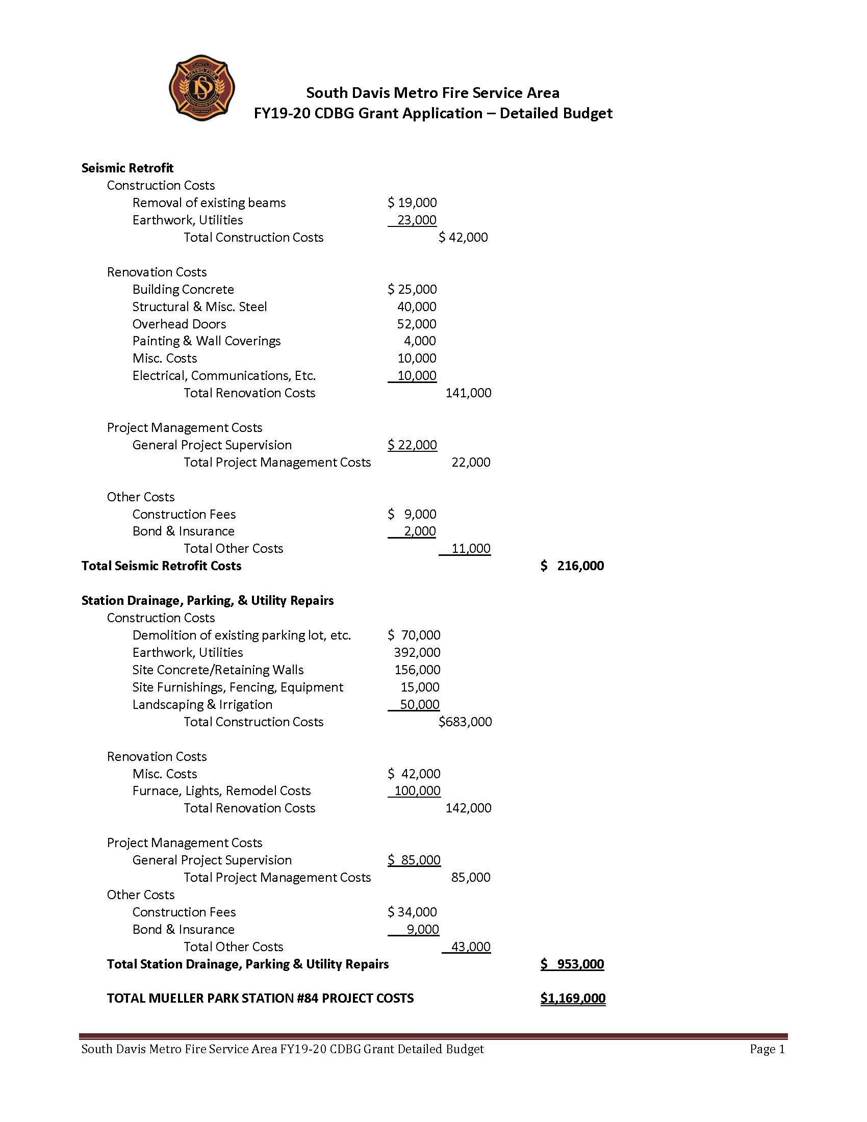
Budget
A detailed program/project budget attachment is a required attachment with your CDBG grant submission
It must show all program/project expenses for your organization
Detail the overall project, including personnel, management, utilities, other costs
If your organization has a federal de minis rate for personnel, please note that in the personnel portion of your budget.
Please Note: CDBG applications without a detailed budget attachment will be deemed incomplete and will not be considered.

Slide 29

Questions
QUESTIONS?

