Slide 1


Slide 2






Notes:
Ask students to share what activities make them feel good.
Some examples make include:
Art
Games
Reading
Sports

Slide 3
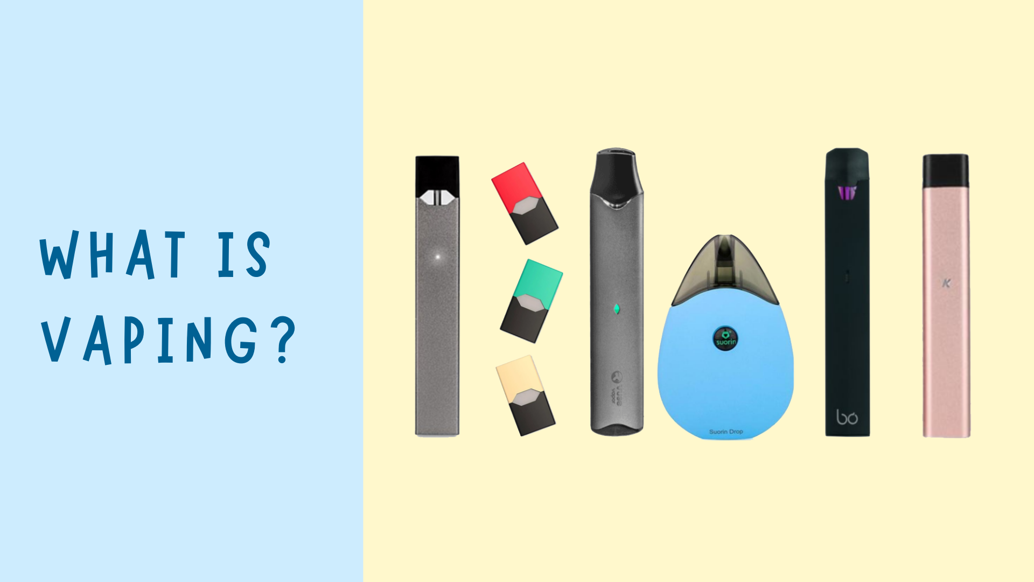
1
Notes:
Electronic cigarettes or e-cigarettes are devices that heat a liquid that usually contains nicotine, flavorings, and other chemicals creating an aerosol that users will inhale
E-cigarettes are commonly referred to as “e-cigs” or "vapes”
Vaping is the act of using an e-cigarette

Slide 4
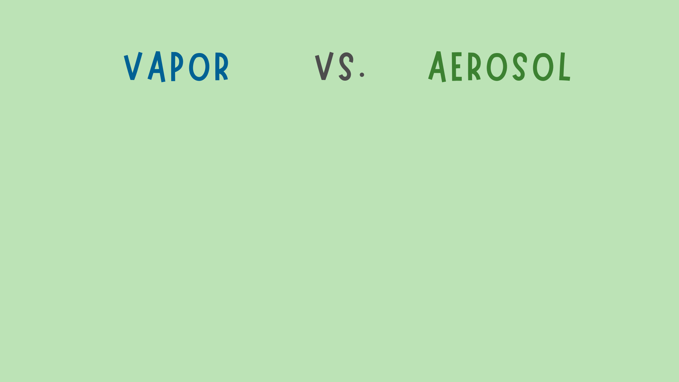

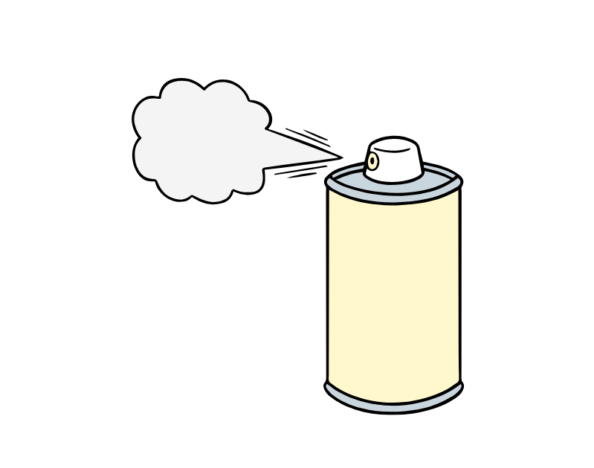
Notes:
Vapor is a substance in a gaseous state
For example, if you boil water, the steam is water that has changed from a liquid to a gas
Aerosol is a suspension of solid or liquid particles within a gas
Commonly used aerosol products include hairspray, spray paint, air freshener, etc.
E-cigarette "vapor" is not actually water vapor The aerosol contains harmful chemicals

Slide 5
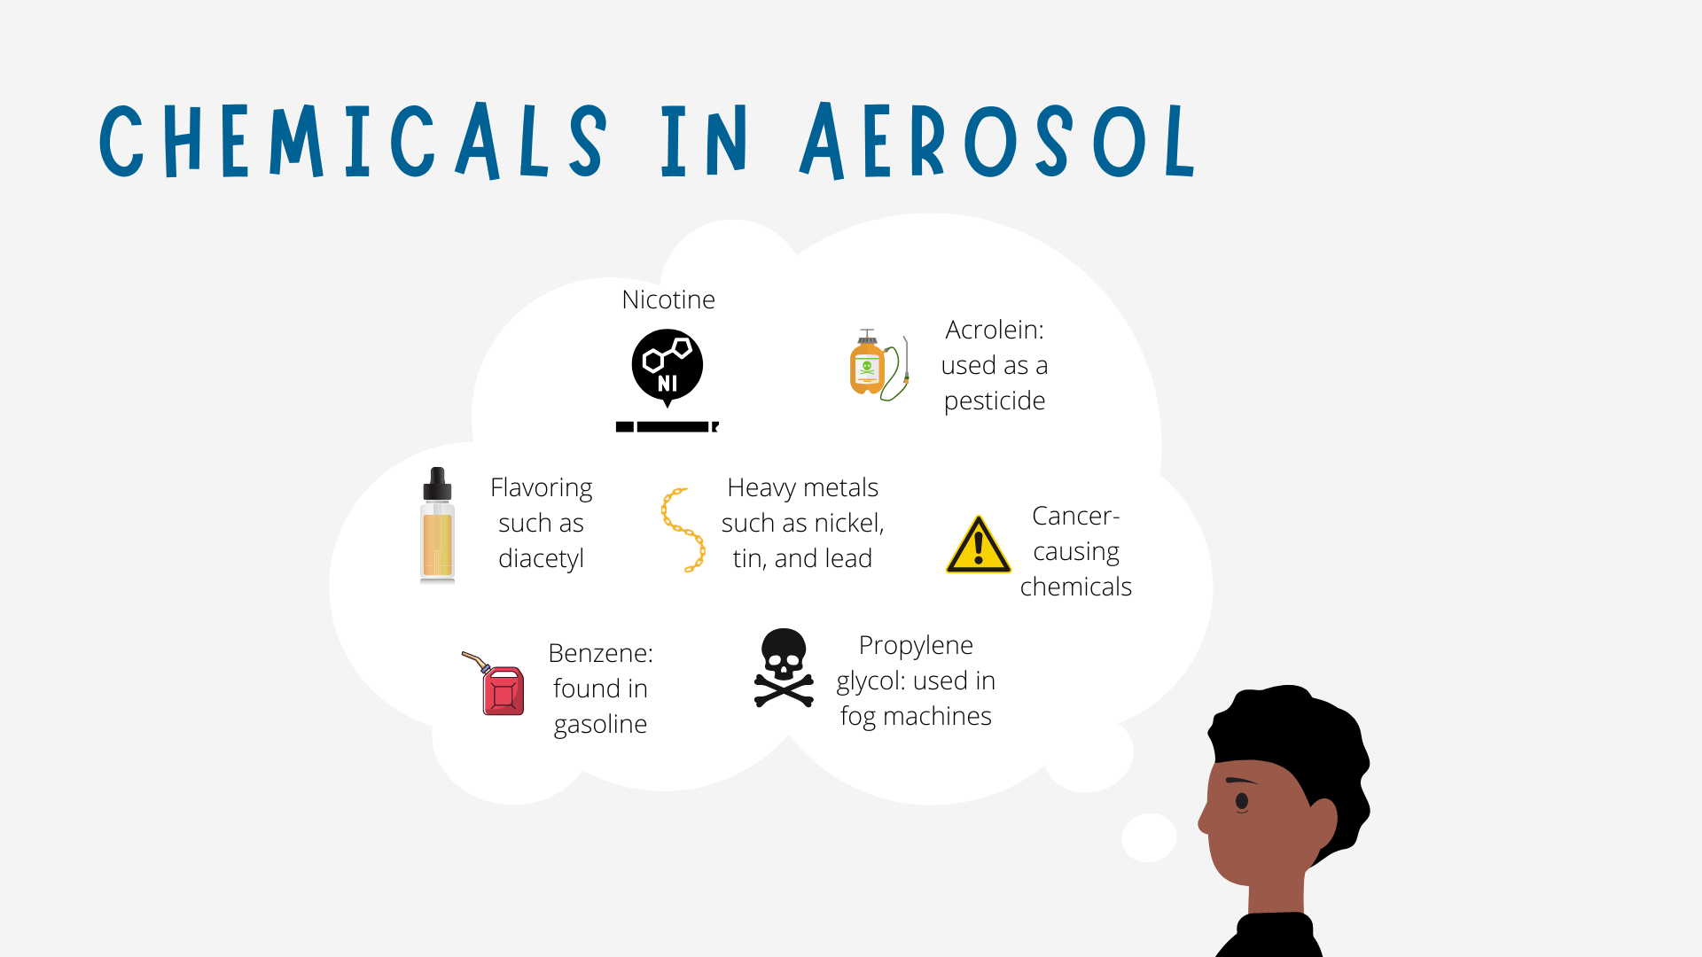
2
Notes:
Chemicals found in e-cigarette aerosol:
Heavy metals like iron, tin, and lead
Propylene glycol, (pro-pyl-ene gly-col) a common food additive
Also used in fog machines to create fake smoke
Acetaldehyde (a-see-tal-die-hide) and formaldehyde (form-al-de-hyde), chemicals known to cause cancer
Benzene (ben-zeen), which is found in gasoline
Acrolein (ak-ro-leen), a pesticide used to kill weeds
Can cause irreversible lung damage
Various flavor chemicals
Nicotine

Slide 6

Notes:
Nicotine is found in 99% of e-cigarette products
Nicotine is a highly addictive drug
Nicotine can affect various areas of the body

Slide 7
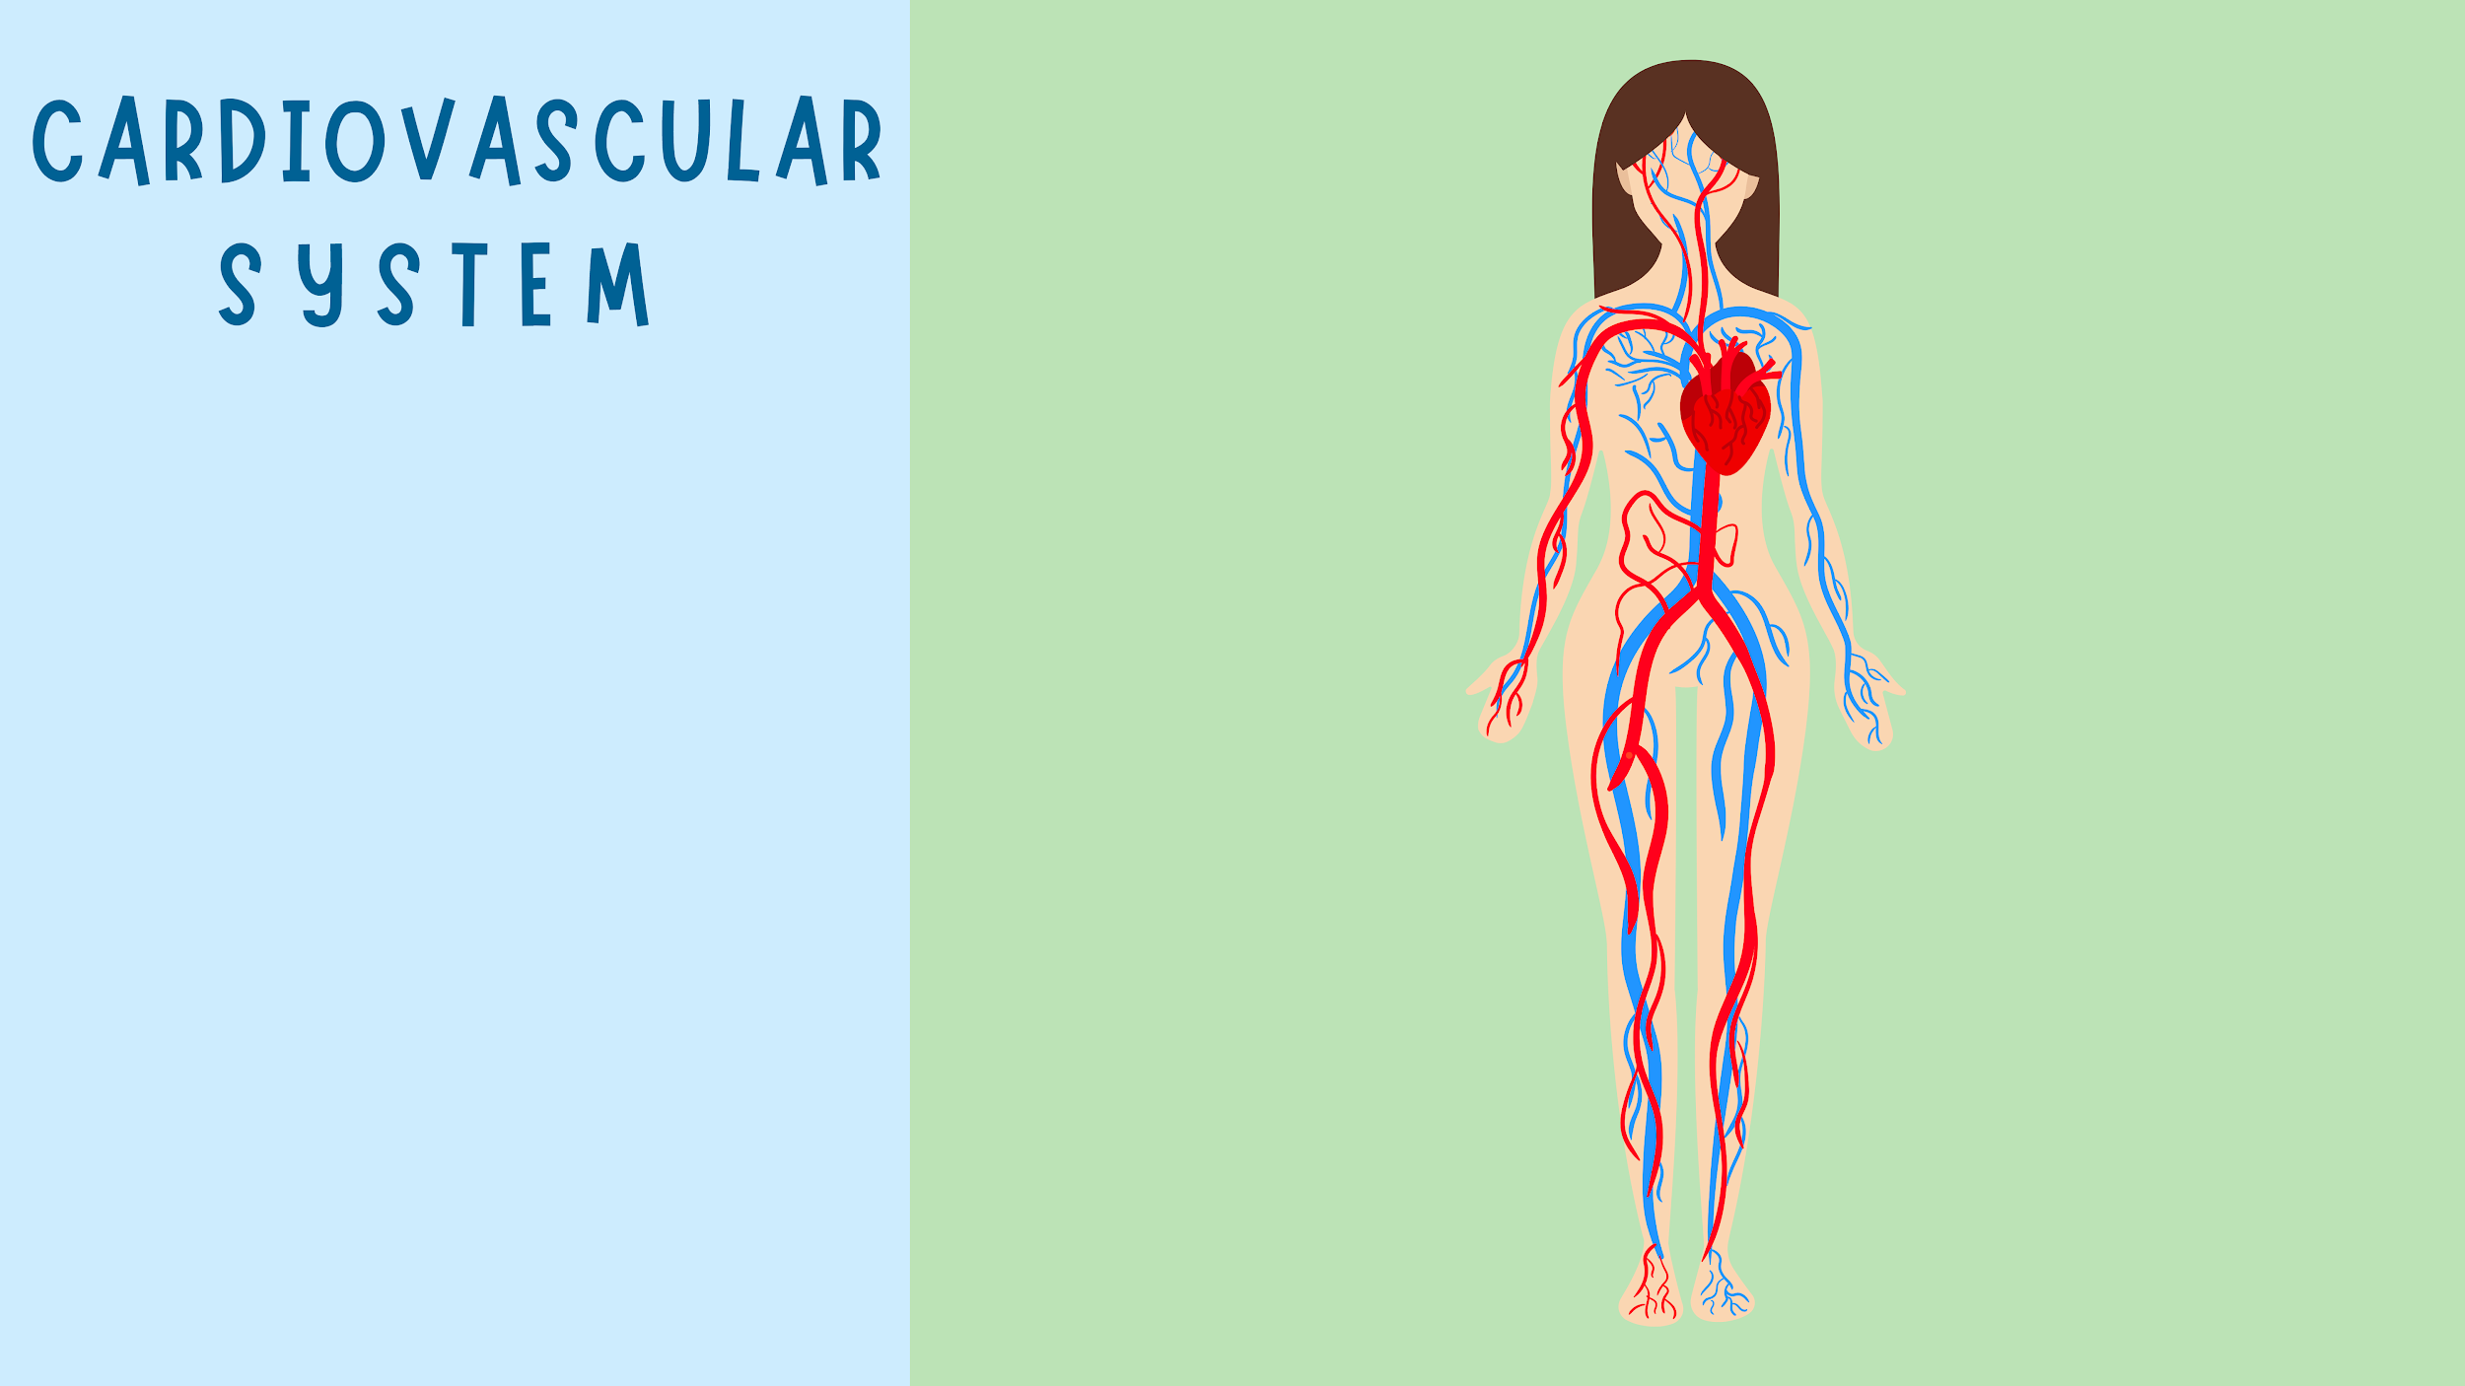
Notes:
Organs affected: Heart and blood vessels
In a healthy cardiovascular system the heart pumps oxygen through the blood to all of the organs
Nicotine causes blood vessels to narrow, which limits the amount of blood that can flow
Nicotine stays in your system for six to eight hours
The lack of blood flowing to the heart can cause blockages, which can lead to serious health conditions, including heart disease and stroke
Heart disease: Heart disease is a range of conditions that affect the heart
An example of this is when the blood stops flowing to your heart, which leads to a heart attack
Stroke: A stroke is when the blood stops or is interrupted from going to your brain

Slide 8
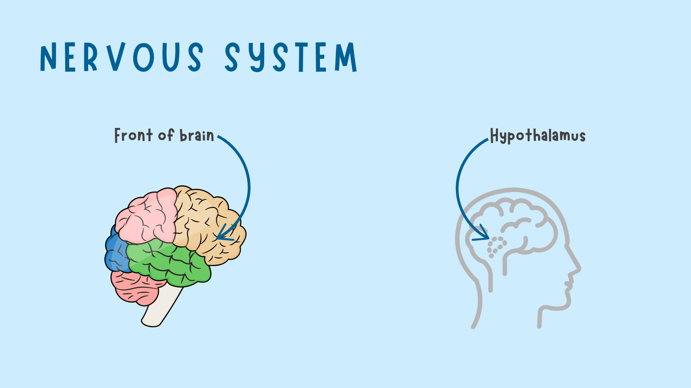
Notes:
Area affected: Front part of the brain
Using nicotine when you are young can harm the front part of the brain which controls attention, learning, mood, and impulse control
This part of the brain is still developing until the age of 25
Area affected: Hypothalamus
When you inhale nicotine from vaping, your brain releases the chemical, dopamine, in your brain
Dopamine can make you feel good, which can lead to addiction

Slide 9
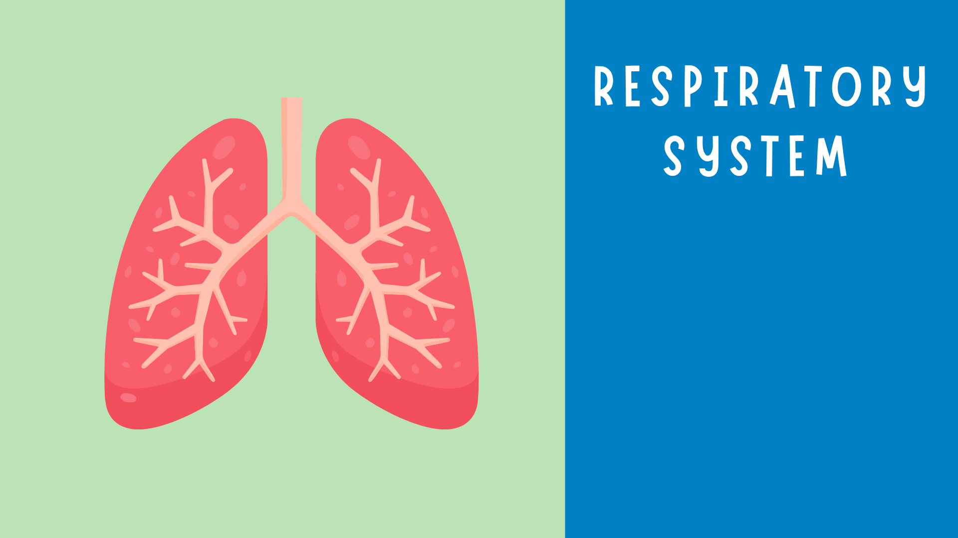
Notes:
Organ affected: Lungs
Harmful chemicals from e-cigarettes can trigger asthma attacks
Vaping can also cause mild to severe damage to your lungs that's irreversible
It can affect your quality of life, which means it's harder to run, play, and do all the things you enjoy

Slide 10
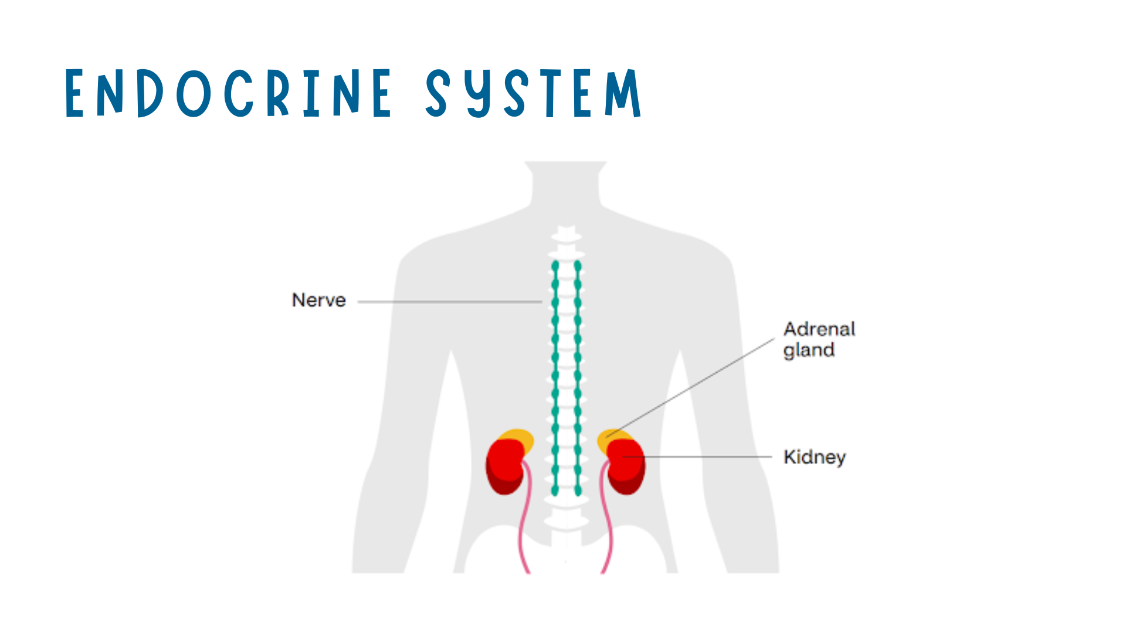
3
Notes:
Area affected: Adrenal glands
When you vape nicotine, an excess amount of a hormone called epinephrine (ep-uh-nef-rin) is released in the bloodstream
Epinephrine increases your blood pressure and heart rate
High blood pressure and heart rate increases your risk of heart disease.
The heart gets tired and starts to wear down sooner than someone who doesn't vape

Slide 11


4
Notes:
You've now learned about how vaping affects different parts of your body
The tobacco industry uses fun flavors to tempt young people to use e-cigarettes
Flavors hide the harshness of nicotine and other chemicals, which makes it easier and more tempting to use
Flavors make vaping seem safe and are similar to your favorite treats

Slide 12

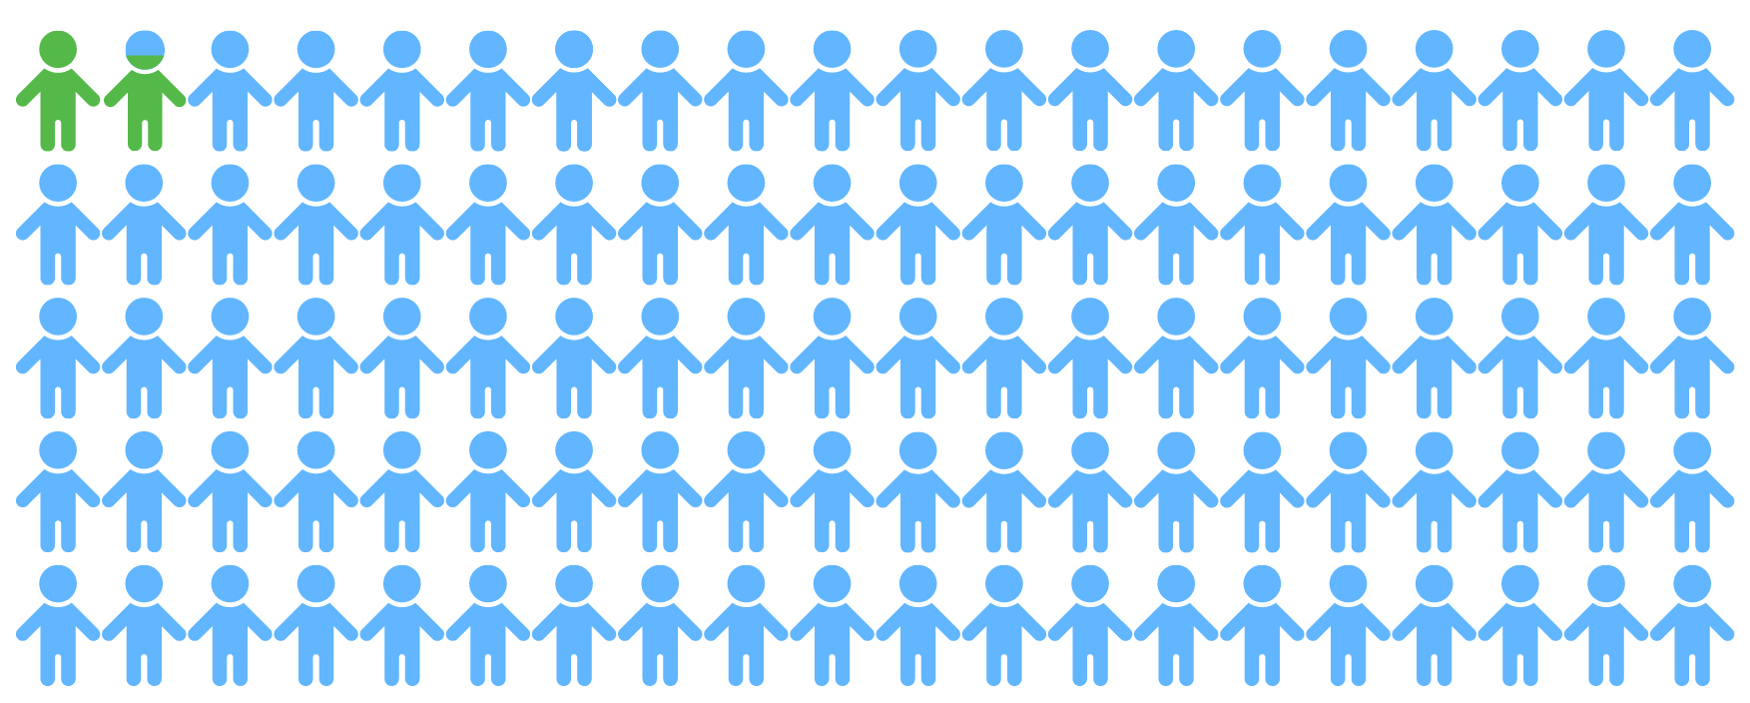
5
Notes:
The media makes it seem like vaping is more common than it is
Only 1.8 out of 100 6th graders in Utah have vaped in the last 30 days

Slide 13
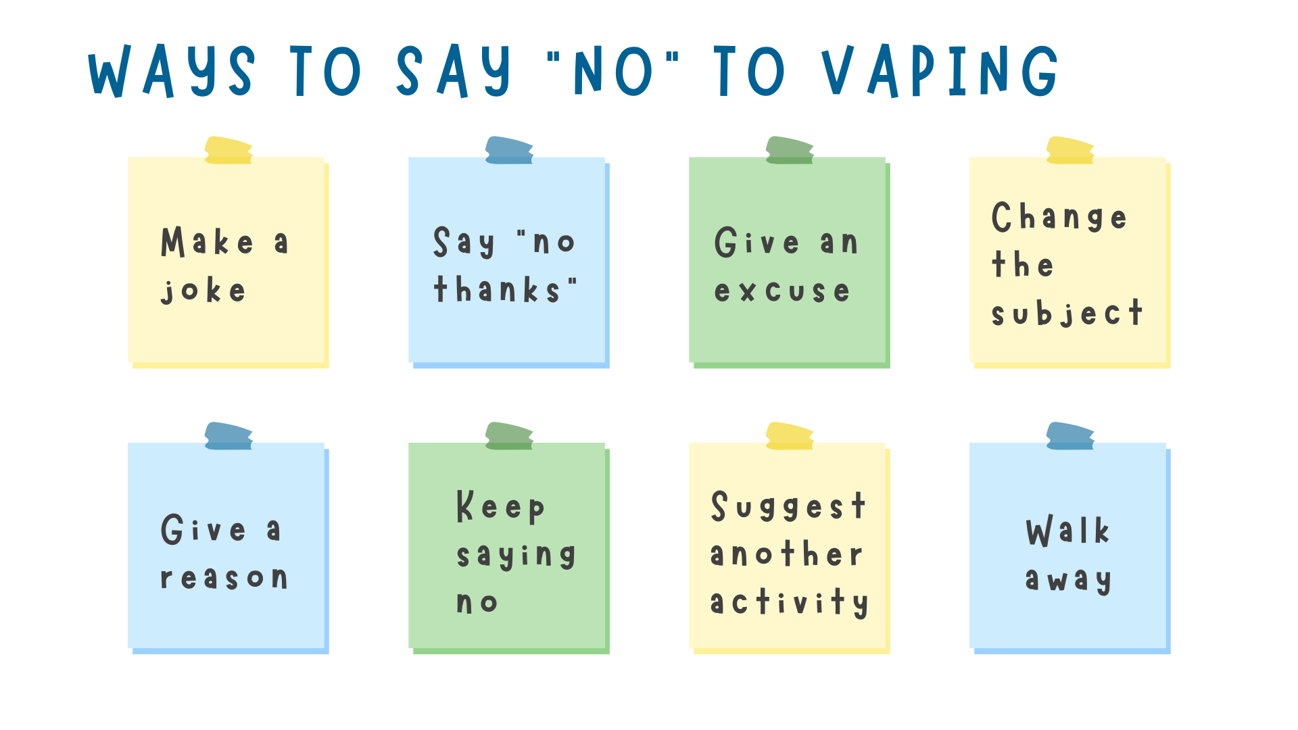
Notes:
Make a joke: Humor is a good way to deal with a situation, as it can lighten the mood.
Say "No thanks": In some situations, a simple "No thanks" will do the job.
Give an excuse: Example: "My parents would ground me if they knew" or "I need to go and do my school work."
Change the subject: Pretend that you didn't hear the suggestion to vape and change the subject to a different topic.
Give a reason why it's a bad idea: Example: "Vaping is harmful to your mind and body" or "Vaping is addictive."
Keep saying no: You may have to say "no" more than once. You don't have to give in just because someone asks you multiple times.
Suggest another activity: Example: sports or playing games.
Walk away from the situation: If you feel uncomfortable, do what you can to leave the situation. If someone continues to ask them to vape and won't leave them alone, talk to a trusted adult.

Slide 14



6
Notes:
Pass out Vape-Free Fortune Teller to each student (see Appendix A).
Optional: Have students personalize their fortune tellers with crayons, colored pencils, markers, etc.
Students cut out and fold fortune tellers (see "How to fold a fortune teller")

Slide 15
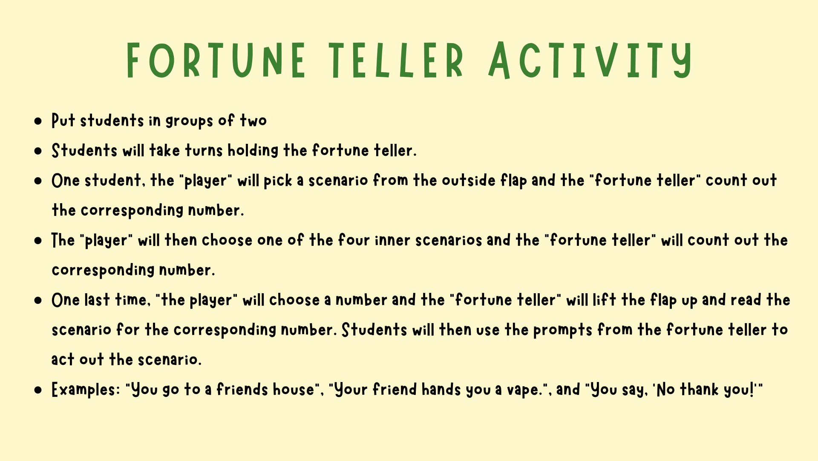

Slide 16



7
Notes:
Talk to a trusted adult
My Life, My Quit "is the free and confidential way to quit smoking or vaping."
You can text "Start My Quit" to 36072 or go to ut.mylifemyquit.org/ to chat with a coach online.

Slide 17





Notes:
True or False: E-cigarettes are not safe to use and contain harmful chemicals.
Answer: True
True or False: Flavors aren't safe to vape.
Answer: True
True or False: Nicotine is addictive.
Answer: True

Slide 18
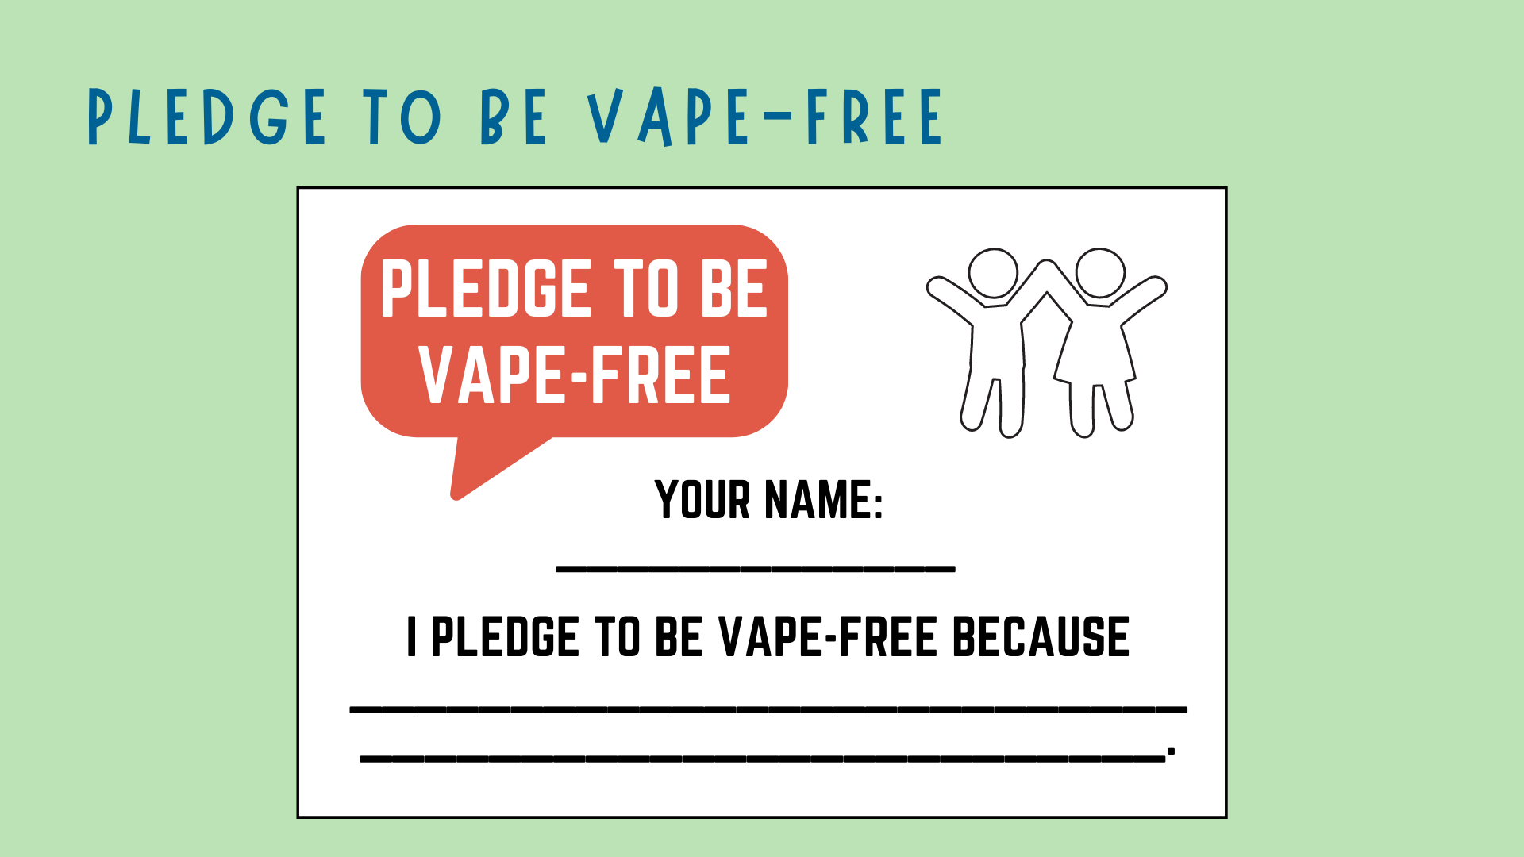
Grades 4-6
Notes:
Hand out the pledge to each student
Have student fill out their name and why they choose to be vape-free
Examples include:
"Vaping is addictive"
"There are dangerous chemicals in e-cigarettes"
"I want to stay healthy"

Slide 19

Vernon ROCKS Coalition. (2021) Vaping. http://www.vernonrocksct.org/vaping/
American Lung Association. (2020). What's in an E-cigarette? https://www.lung.org/quit-smoking/e-cigarettes-vaping/whats-in-an-e-cigarette
CATCH My Breath. (n.d.). Introduction to the Risks of E-Cigarettes and Vaping: Digital Lesson Educator Guide Elementary School Supplemental Lesson Bundle.
Plumas County California. Flavors & Youth. https://www.plumascounty.us/2561/Flavors-Youth
Utah Department of Human Services. Student Health and Risk Prevention: Prevention Needs Assessment Survey Results for Davis County LSAA. https://dsamh-training.utah.gov/_documents/SHARPreports/2021/StateofUtahProfileReport.pdf
WikiHow. (2019). How to Fold a Fortune Teller. https://www.youtube.com/watch?v=CODnVX7VAZ8
My Life, My Quit. Resources. https://ut.mylifemyquit.org/Resource_pages/resources

